Slide 1

Credit Risk Analysis & Insights using Power BI
Overview:
This project analyzes credit applicant data to uncover meaningful patterns in age, employment status, and registration behavior. The dashboard is designed to assist decision-makers in identifying risk profiles and understanding applicant behavior through interactive visualizations.
Tools Used:
Power BI Desktop
DAX (Calculated Columns and Measures
Excel/CSV Data
By:
Ankit Rawat
Data Analyst
ankitrawat.ds@gmail.com
Linkedin

Slide 2
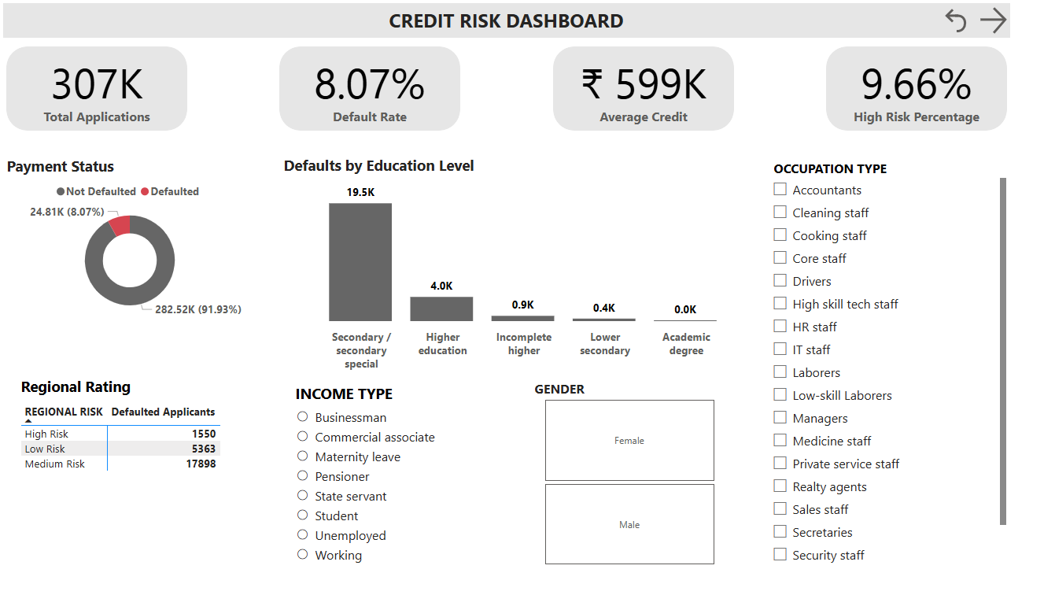

Slide 3
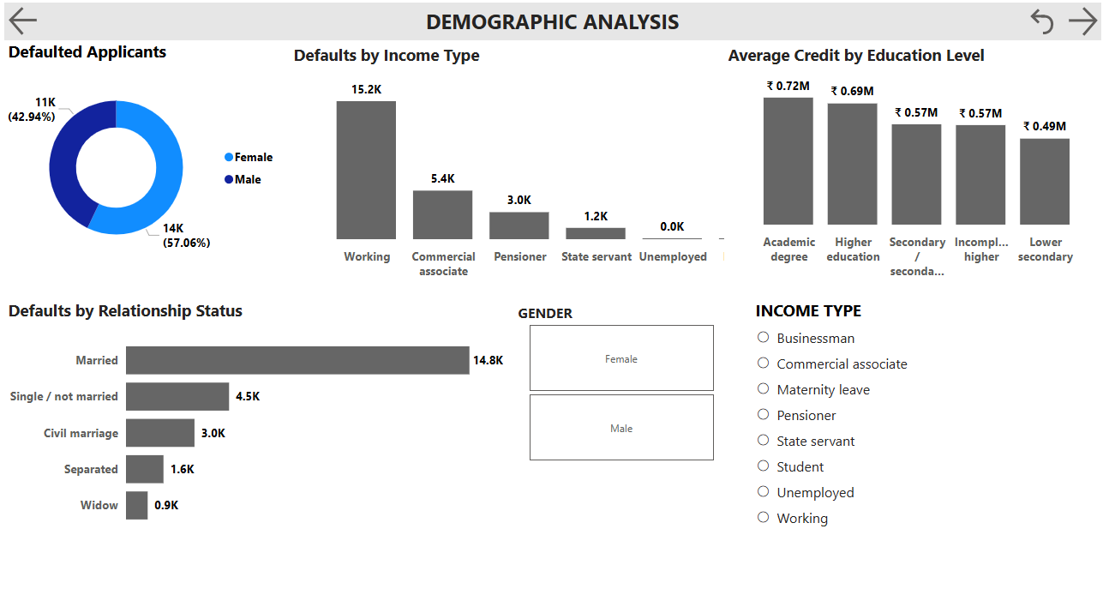

Slide 4
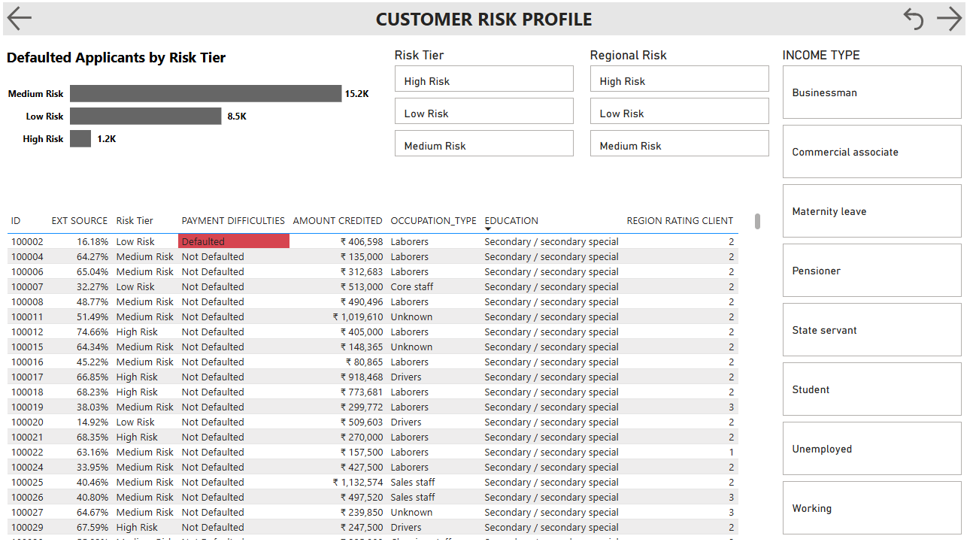

Slide 5
